Slide 1
Retail Store Sales Prediction
UVA School of Data Science Capstone Project
05/03/2023

Slide 2

UVA School of Data Science year-long capstone project focused on real-world application of methods learned throughout the 2-year dual degree program
The semester will be structured around the following goals:
Re-establish communication plan with your client if you have been out of communication.
Establish a meeting schedule for your team based on the semester's course schedule, etc.
Summarize what you learned last semester by creating a brief project report including a scope statement, a list of requirements, and budget if necessary.
Complete the process of establishing your data and preparing it for the modeling and/or deep exploration phase. This will include various forms of data reduction, feature engineering, and data shaping to meet the computational requirements of your models and tools.
Develop and test one or more models, or other data products, that meet your project requirements and expectations; revise these expectations if necessary.
Produce a six-page publishable paper, along with an oral presentation, on your work summarizing your team's research and findings. This will be preceded by an abstract due after spring break.
Package and share any data products and research artifacts for clients and other stakeholders.
Source: UVA School of Data Science

Slide 3




Shreyas Adiyodi
MBA/ MSDS ‘23
Nidhi Shah
MBA/ MSDS ‘23
Ben Wilson
MBA/ MSDS ‘23

Slide 4



The Cross-Industry Standard Process for Data Mining (CRISP-DM) framework was leveraged to guide our modeling approach throughout the capstone project
Define & Understand Business Problem
Understand business objectives and associated processes
Translate business problems into analytical approach
Problem Definition
Collect & Understand Data
Understand data availability, data quality, data insights
Form hypothesis of expectations
Data Feasibility
Explore & Analyze Data
Explore to data to identify associations, anomalies, trends, patterns, and relationships
Selected & Cleaned Data
Build & Validate Model(s)
Build & iterate model to refine performance
Conduct sensitivities to evaluate validity of results
Analytical Results
Integrate Qualitative Insights
Translate analytical results into business terms
Integrate qualitative insights for well-rounded insights
Actionable Business Insights
Source: UVA School of Data Science

Slide 5
Table of Contents
Problem Statement
Data Preparation
Exploratory Data Analysis
Modelling Performance
Qualitative Insights
Final Recommendations

Slide 6
01.
Problem Statement

Slide 7
Predicting sales across 3k+ stores within different countries requires great care in understanding cultural, regulatory, and seasonal differences
Fluctuations in customer demand can greatly impact the financial performance of a business. Therefore, accurately estimating future sales and customer demand is essential for business growth. Sales forecasting involves predicting the sales or demand for a specific product during a certain period. Our paper demonstrates we are able to use modern machine learning principles to predict sales for a retail drug store chain with 3k stores in 7 countries. In our analysis, we assess how sales are impacted by factors such as promotions, competition, holidays, seasonality, and location.
Currently, store managers are tasked with predicting their daily sales up to six weeks in advance, and this process can lead to inconsistent results due to individual factors. As such, accurate predictions, especially for perishable or time sensitive items, is incredibly important so increasing sales and growing the business.
Source: Retail store chain

Slide 8
Retail store chain provided 3 datasets with macro level insights into each unique store, although the data requires merging to extract necessary understanding
Dataset Description
You are provided with historical sales data for 1,115 stores. The task is to forecast the "Sales" column for the test set. Note that some stores in the dataset were temporarily closed for refurbishment.
Data Files
train.csv - historical data including Sales
test.csv - historical data excluding Sales
store.csv - supplemental information about the stores
Data Fields
Id - an Id that represents a (Store, Date) duple within the test set
Store - a unique Id for each store
Sales - the turnover for any given day (this is what you are predicting)
Customers - the number of customers on a given day
Open - an indicator for whether the store was open: 0 = closed, 1 = open
State Holiday - indicates a state holiday. a = public holiday, b = Easter holiday, c = Christmas, 0 = None
School Holiday - indicates if the (Store, Date) was affected by the closure of public schools
Store Type - differentiates between 4 different store models: a, b, c, d
Assortment - describes an assortment level: a = basic, b = extra, c = extended
Competition Distance - distance in meters to the nearest competitor store
Competition Open Since - approximate year and month of the time the nearest competitor was opened
Promo - indicates whether a store is running a promo on that day
Promo2 - Promo2 is a continuing and consecutive promotion for some stores: 0 = store is not participating, 1 = store is participating
Promo2 Since - describes when the store participated in Promo2
Promo Interval - describes the consecutive intervals Promo2 is started
Source: Retail store chain

Slide 9
02.
Data Preparation

Slide 10


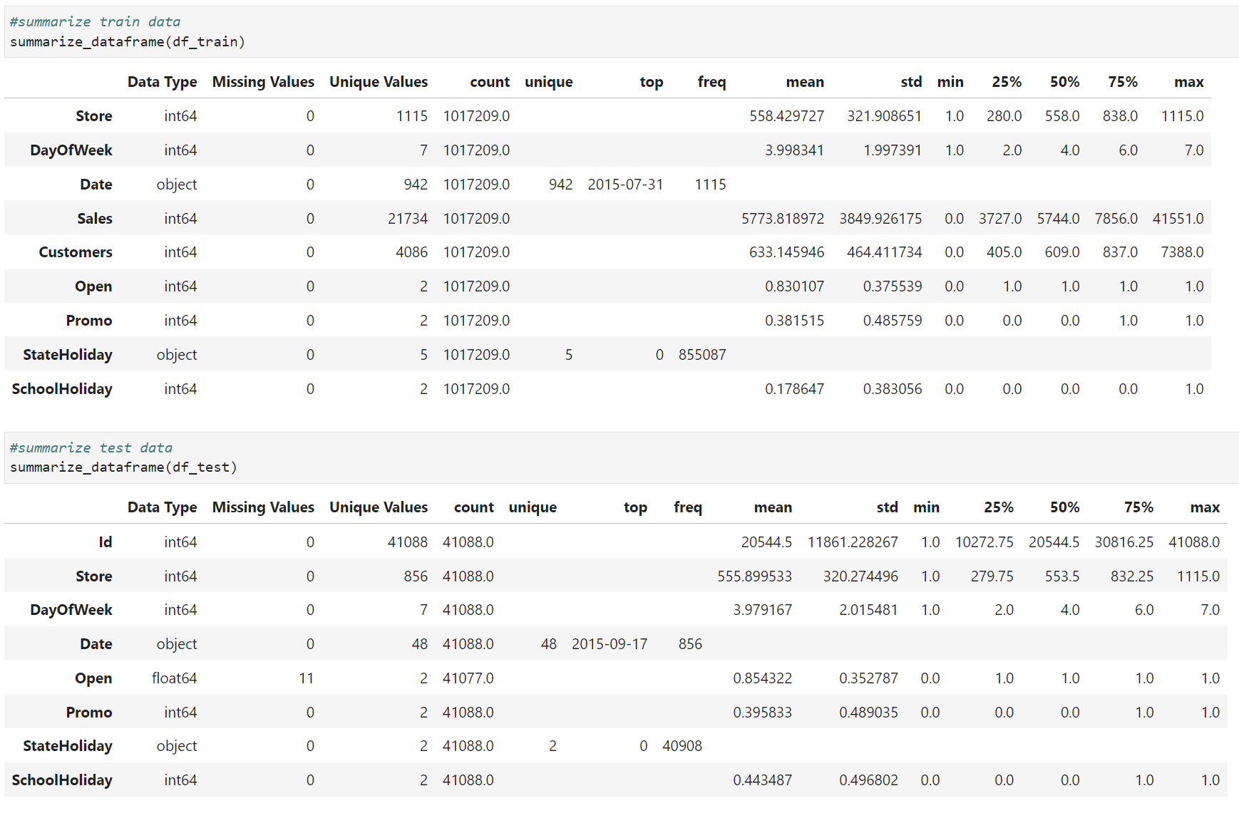
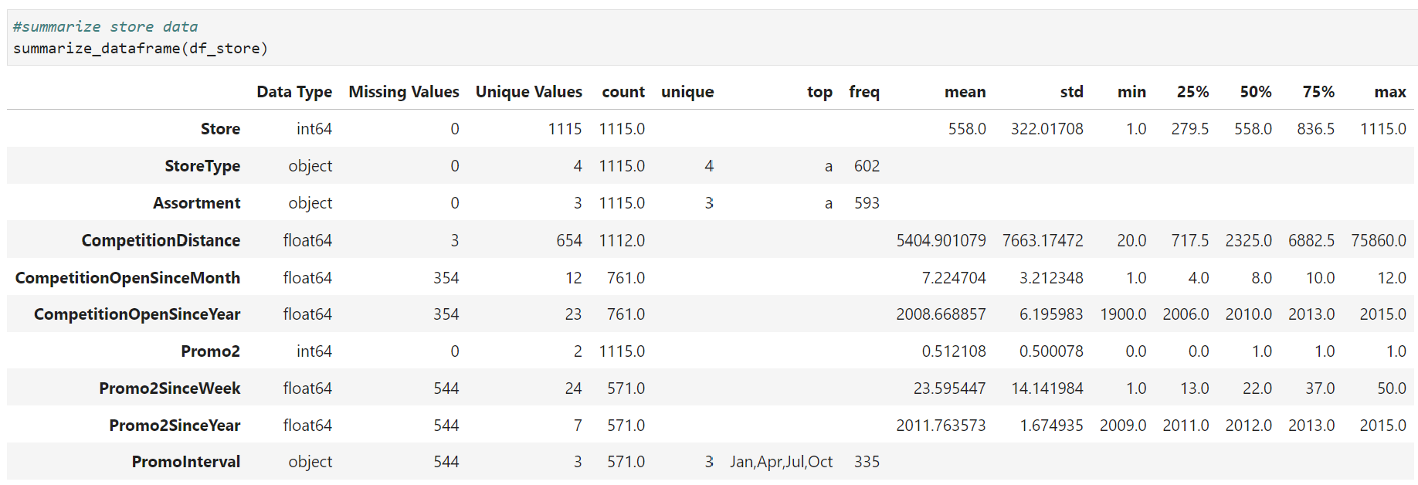
A light data cleansing process was undertaken to prepare 2.34k null values, merge files, and encode categorical features for regression purposes
Summarization identifies null values within store data |  | 4 transformation steps taken to prepare data
Preparing the dataset for modelling requires key steps to verify the optimal performance is achievable. The following steps were taken to prepare the data files for the modelling step:
Replace Nan Inputs – The NaN input reviles a null value within the cell. Such values can be found for the below fields are were replaced with a ‘0’ in the updated data, indicating that there was for example no promotion.
Open, Competition Distance, Competition Open Since Month, Competition Open Since Year, Promo 2 Since Week, Promo 2 Since Year, Promo Interval
Deploy Ordinal Encoder – The categorical features such as store type require transformation into a numerical value for regression purposes, so an ordinal encoder was utilized for the conversion.
Merge Files – The ‘Store’ file was merged with both the ‘Train’ and ‘Test’ files to verify that all useful information was incorporated into the modelling process.
Remove Date – For the final modelling step, the ‘Date’ field was removed as it would cause errors when running a regression based model. To verify the information is incorporated into the modelling process, it was divided into day, month, and year.
Source: Team analysis

Slide 11
03.
Exploratory Analysis

Slide 12










Exploratory analysis covered internal store decisions and external market influences to quantify trends and impacts to sales
Internal Decisions
External Influences
Correlation of Attributes
Quantify degree of association between variables and sales to assess relationship
Seasonality
Verify seasonality trends in sales by year, month, and week across stores
Store Type
Compare four store types to determine size and performance
Exploratory Analysis
Holiday
Gauge impact to sales from store and state holiday trends
Store Comparison
Compare individual stores to quantify differences and outliers
Competition
Sales elasticity impact based upon competition distance and age
Promotion Type
Evaluate success of different promotions performed to generate sales growth
Day of the Week
Determine store closures and day of the week sales trends
Source: Team analysis

Slide 13


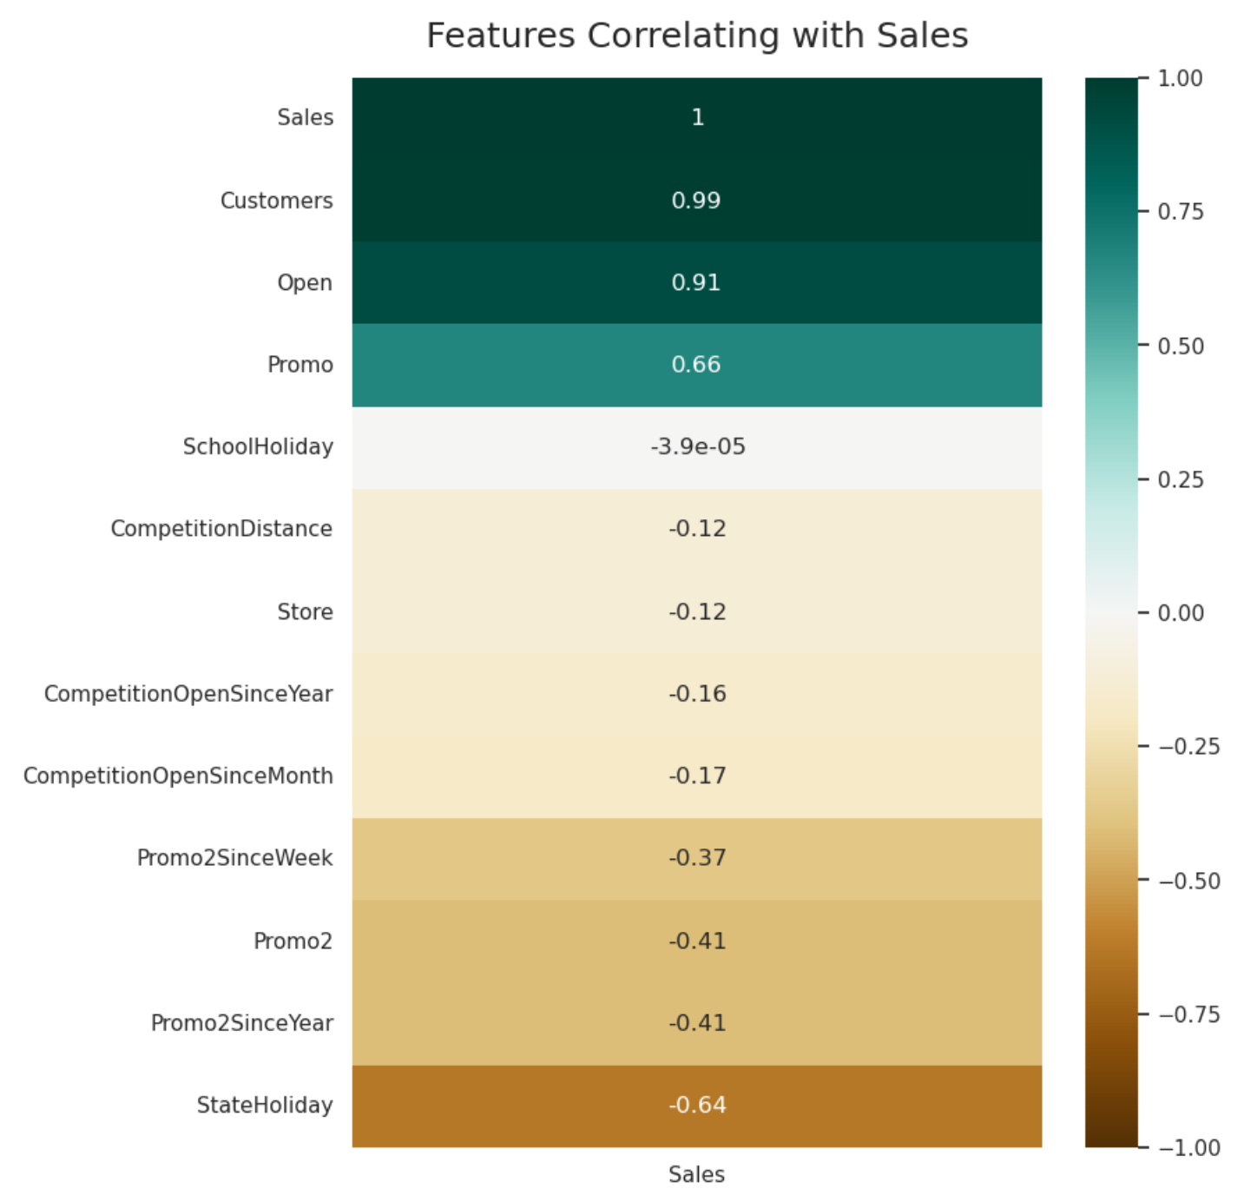
Strong correlations between 7 data attributes and Sales identifies a clear path for focus when developing models to enhance Sales predictions
Correlation reveals key numerical attributes |  | 7 attributes with strong correlations to guide team
Customers have unsurprisingly a nearly perfect positive correlation with Sales, indicating that this is a powerful prediction tool for future sales although will be unavailable for predicting in the test data.
Similarly, StateHoliday has a unsurprisingly strong correlation to sales as stores are unable to sell items when closed.
Promo 2 indicates a fairly strong negative correlation with Sales, identifying a takeaway that the second promotion offered by stores was largely ineffective at increasing sales. This is quite different from Promo where the first promotion has a very strong correlation with a sales increase.
An interesting takeaway is the low correlation of the competition features to sales, as one may believe that the closer a competitor is or the longer said competitor has been in business, the lower sales would be. Although this is the case, the correlation is fairly weak.
Source: Team analysis

Slide 14


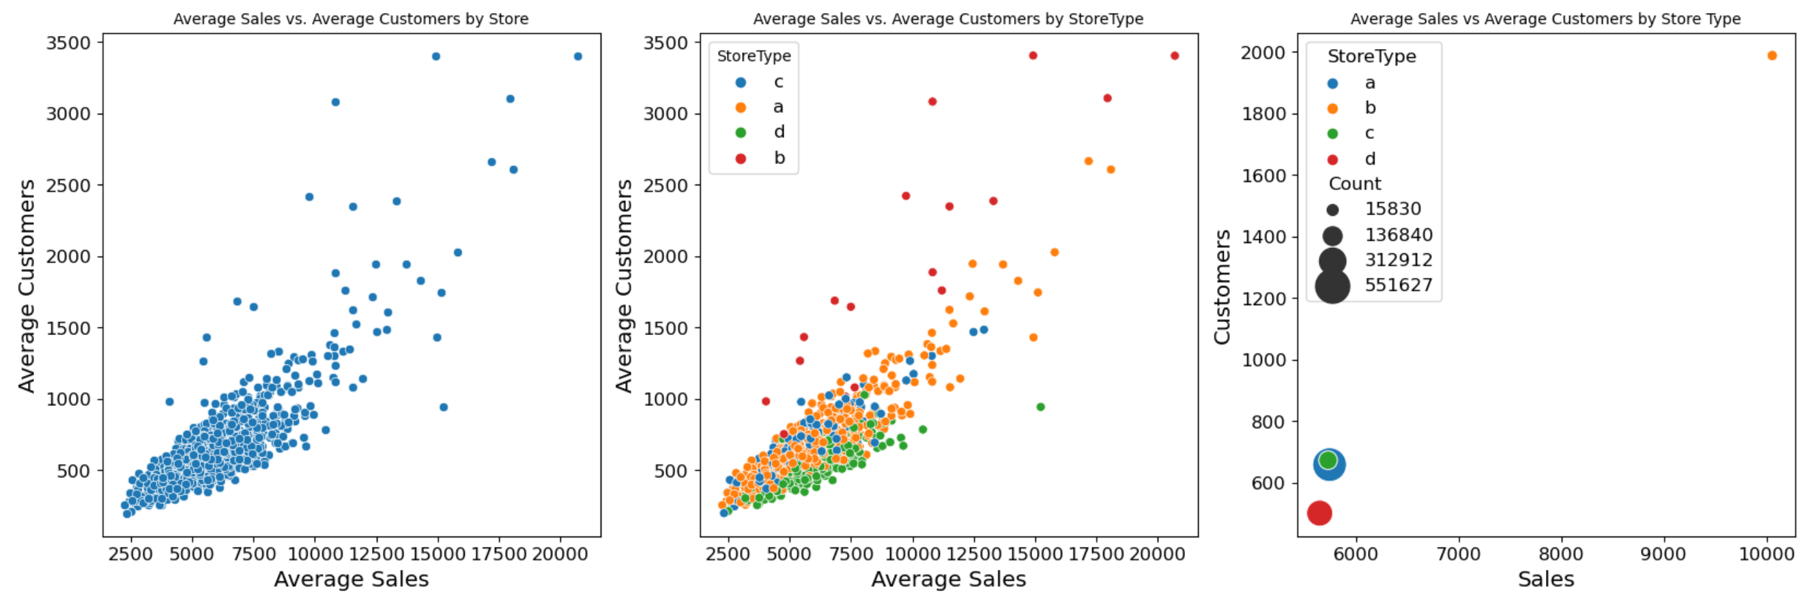
Store type B, although fewer stores, consistently outperforms others with $4k greater sales and 1k+ greater customers on average
Outlier stores create comparison issues
D stores consistently perform lowest
B stores outperform by a wide margin
Outlier stores types B with high avg. sales and customers
Outlier stores for sales & customers
D Store Type low performance
20+ stores see above average sales and customers, driving major growth of sales predictions
Store type D performs below average compared to the other 3 store types in customers and sales
Store type B, although limited in number of stores, has a high # of customers per sales, indicating low basket size per customer
Source: Team analysis

Slide 15

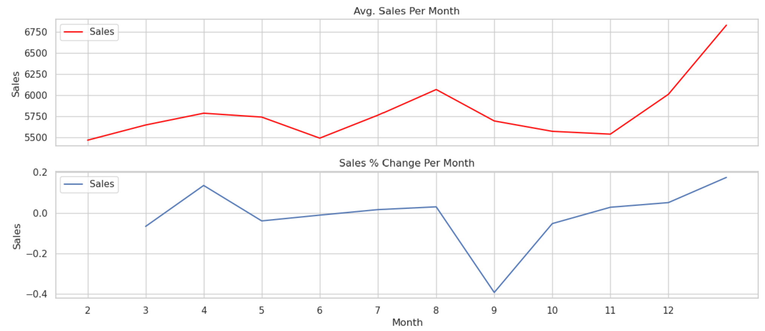
Monthly sales seasonality is present with 2 significant swings down and up spaces consistently throughout the year
Seasonality negatively impacting sales in June and November |  | Commentary
Multiple sales drops and precipitous increases can be seen throughout the monthly sales cycle
Decrease of November sales of -40% followed by ~10% growth in December shows holiday seasons materially influence sales cycles
A ~15% sales increase in April should be factored into further analysis to understand cause for future predictions
Seasonality sales dips throughout year
Source: Team analysis

Slide 16


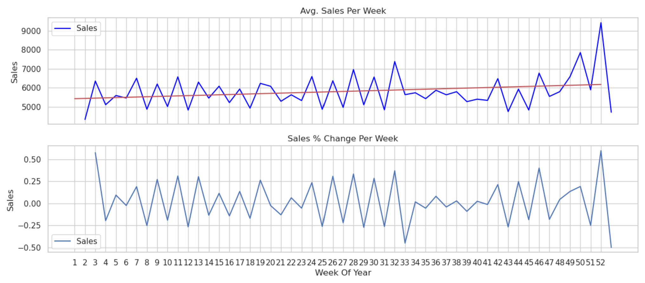
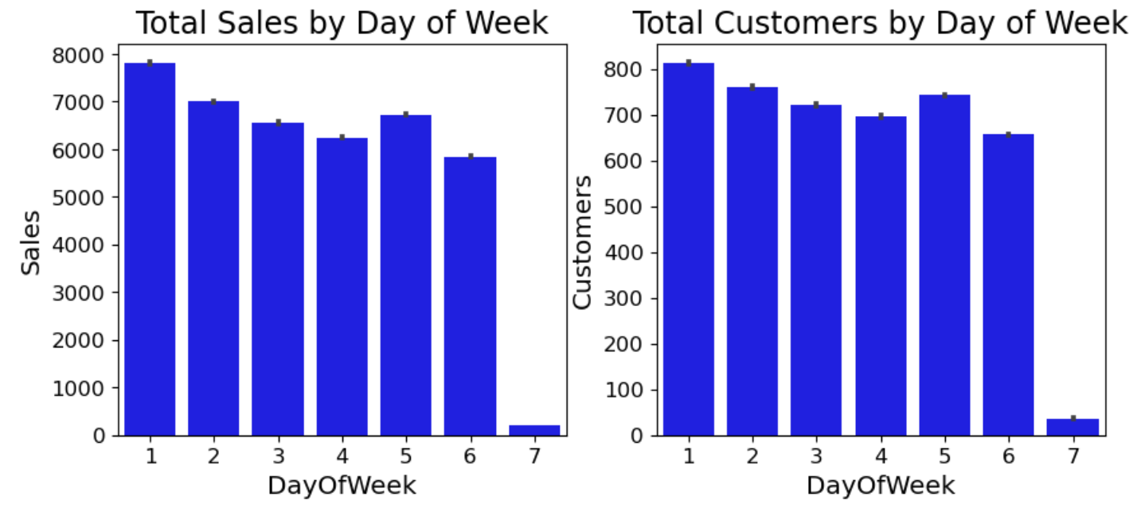
Sunday store closures significantly influence weekly sales cycle for stores predictions
Weekly sales changes correlate to promotions |  | Sunday store closures leads to Monday spikes
Gradual sales increase throughout year
Sunday store closures
Slight sales increase throughout the year can be seen from regression line, indicating sales predictions at the end of the year should be progressively greater
Large sales swings from spikes in chart influenced materially by promotion schedule and store closures
Gradual decrease in store sales throughout week dependent upon day with most stores closed on Sunday
Minor sales increase on Fridays (day 5 on chart), indicating end of week purchases by customers
Source: Team analysis

Slide 17



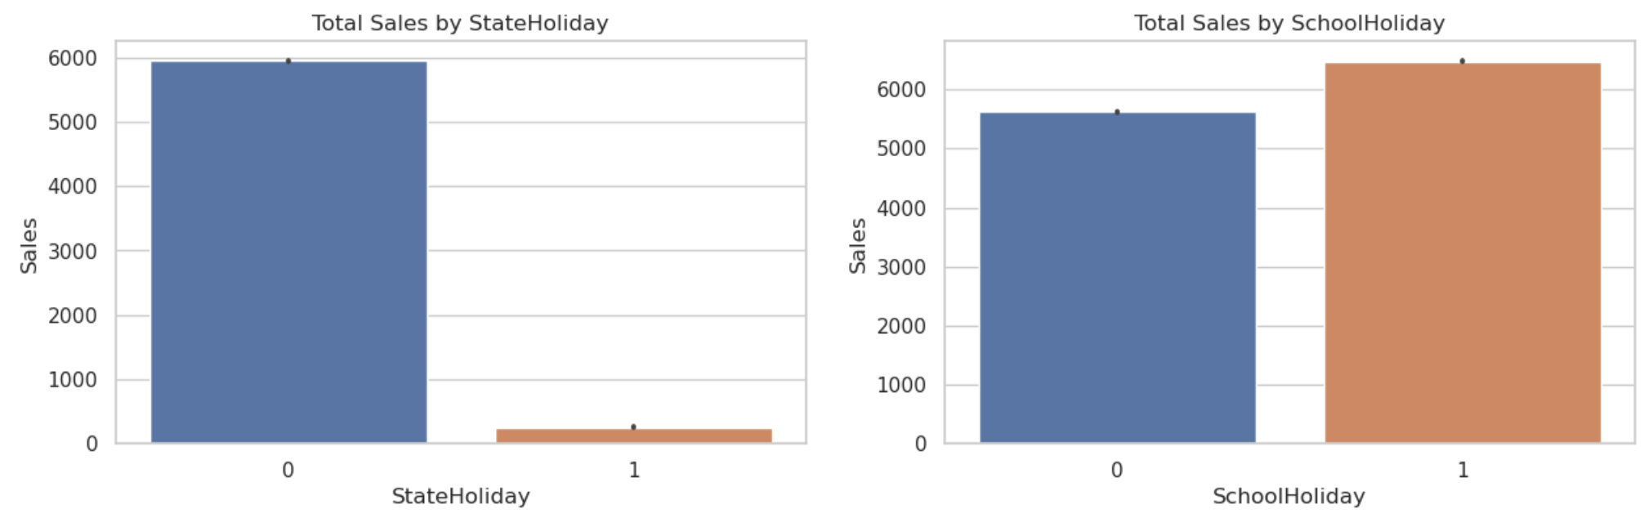
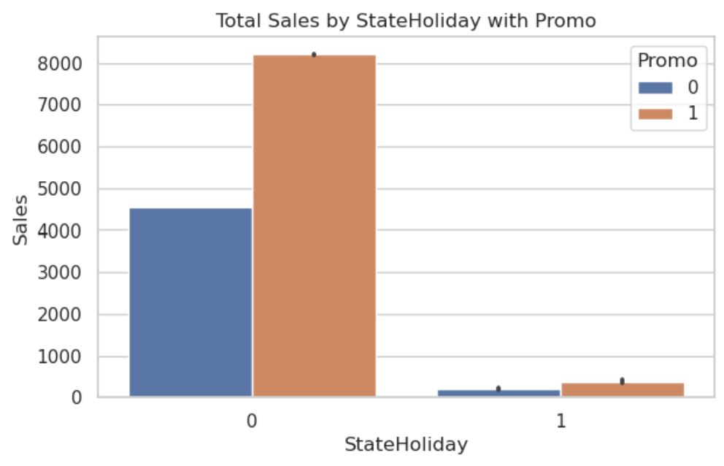
Store closures for state holiday’s yet not for school holiday’s creates effective prediction point in assessing number of store days open for sales week
State holiday closures factor considerably into prediction
School holiday less applicable in sales prediction
Non-holiday with promotion creates positive interaction effect
Marginal sales difference for school holidays
Non-holiday promotions see significant impact
Fewer stores remaining open for designated holidays
Similar to Sunday store closures, few stores choose to open on State holiday’s, likely causing significant sales bump days before such closures occur
Predicting store sales x days prior to store closure for holiday purposes could create strong prediction variable
School holidays show little to no difference in sales between stores, indicating that it is a less powerful attribute to perform predictions with throughout modeling process
Similar variable importance seen in correlation test
Promotions are at initial glance an effective driver of sales and become a strong predictor of future store sales
Few promotions are run on or during holidays given that most stores choose to close
Source: Team analysis

Slide 18


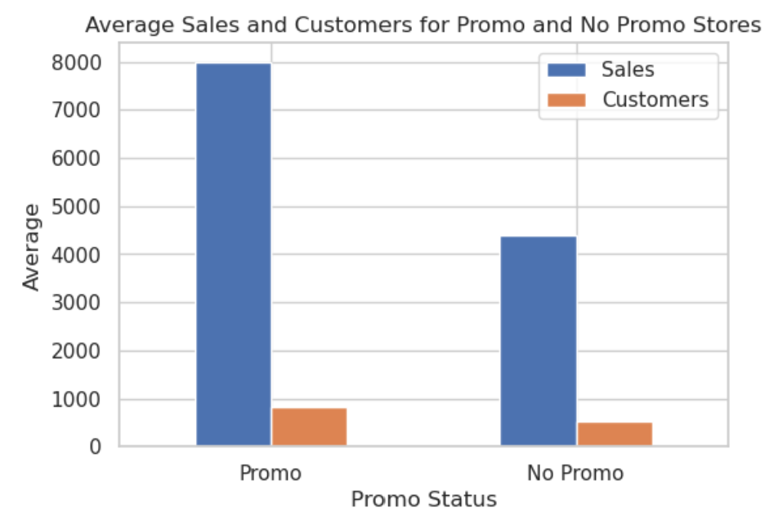
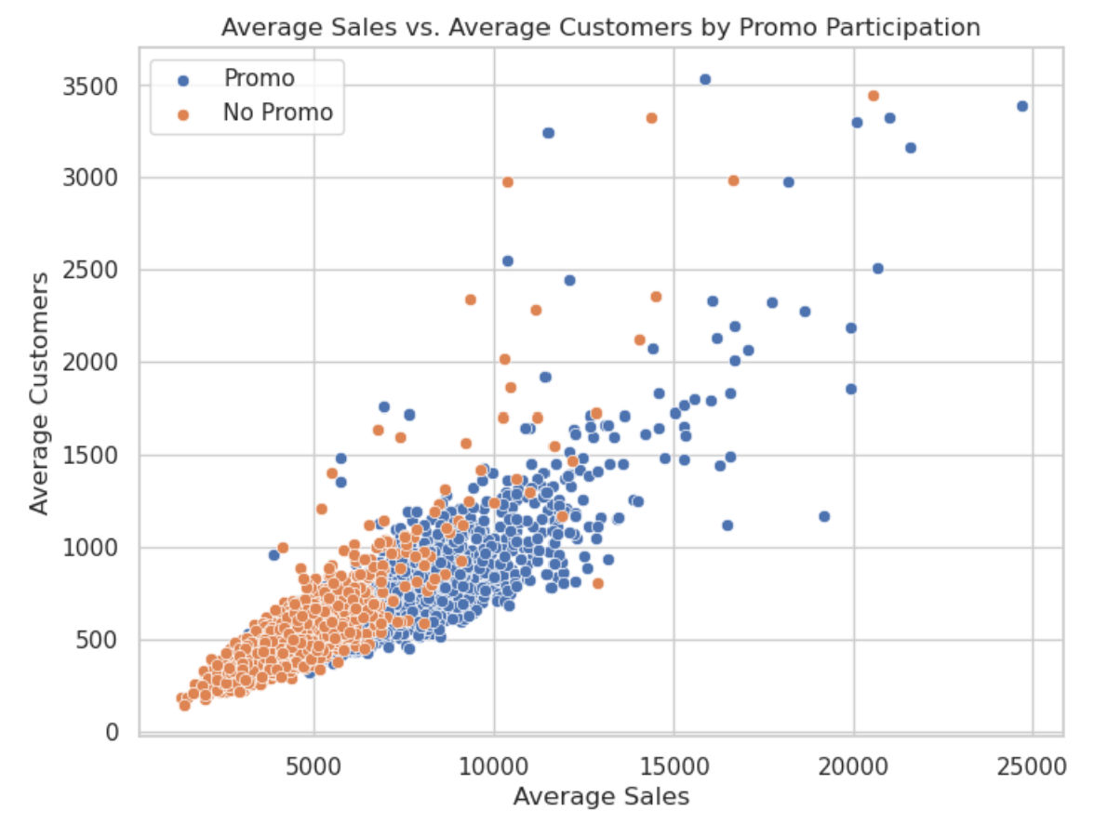
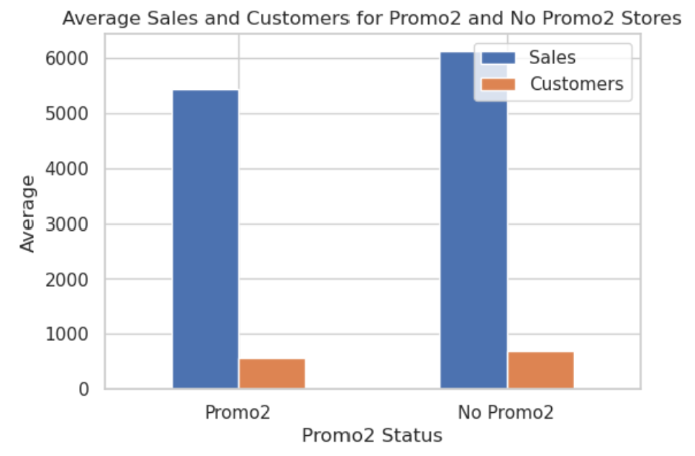
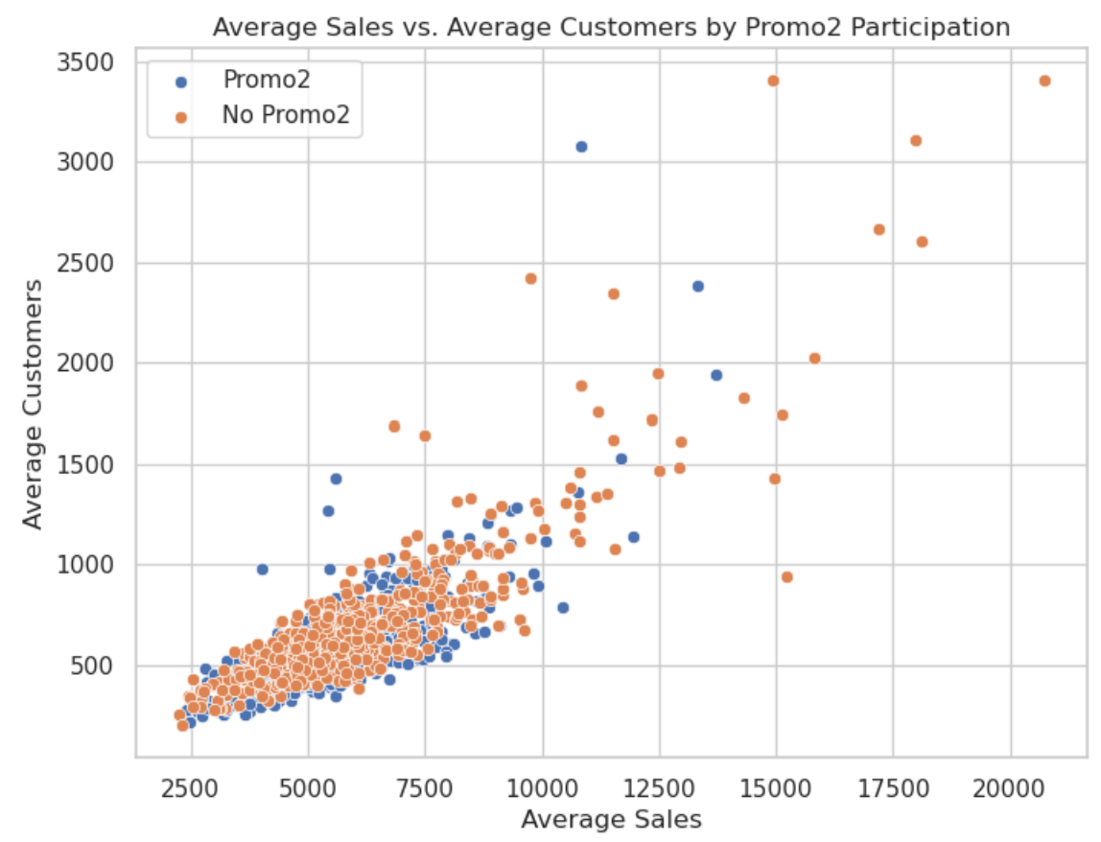
A $4k average sales increase from promo 1 versus $750 average sales decrease from promo 2 initially indicates promo 2 should be removed while promo 1 continues
Promotion type (1 vs. 2) can significantly impacts sales with an immaterial impact to customer count |  | 27 more stores engage in consecutive store promotions (promo 2)
A ~$4k average sales increase is achieved from participating in the single promotion (promo 1)
The single promotion appears to be a success in driving sales growth although cannot say unless further analysis is conducted on the promotion level (i.e. discount on items)
571 stores participated (compared to 544 that did not participate) in consecutive promotions (promo 2) yet see a decline of ~$750 on average sales from doing so
The consecutive promotion appears to be unsuccessful as a discount was provided to items yet drove fewer average sales than without the promotion
~$4k sales increase from promotions
$750 avg. sales drop
from promotions
Source: Team analysis

Slide 19
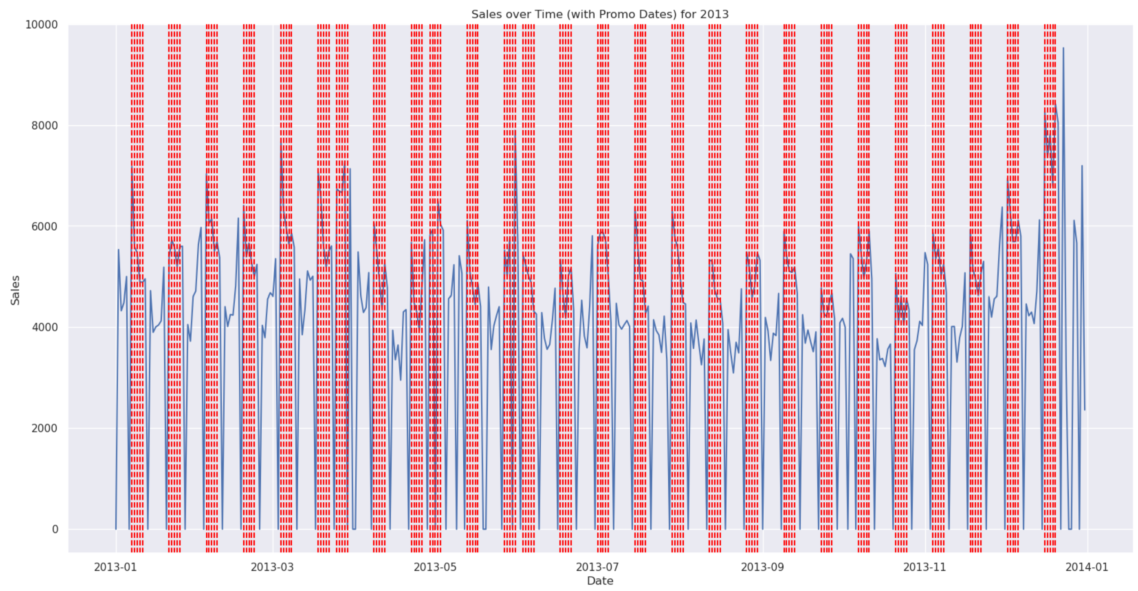
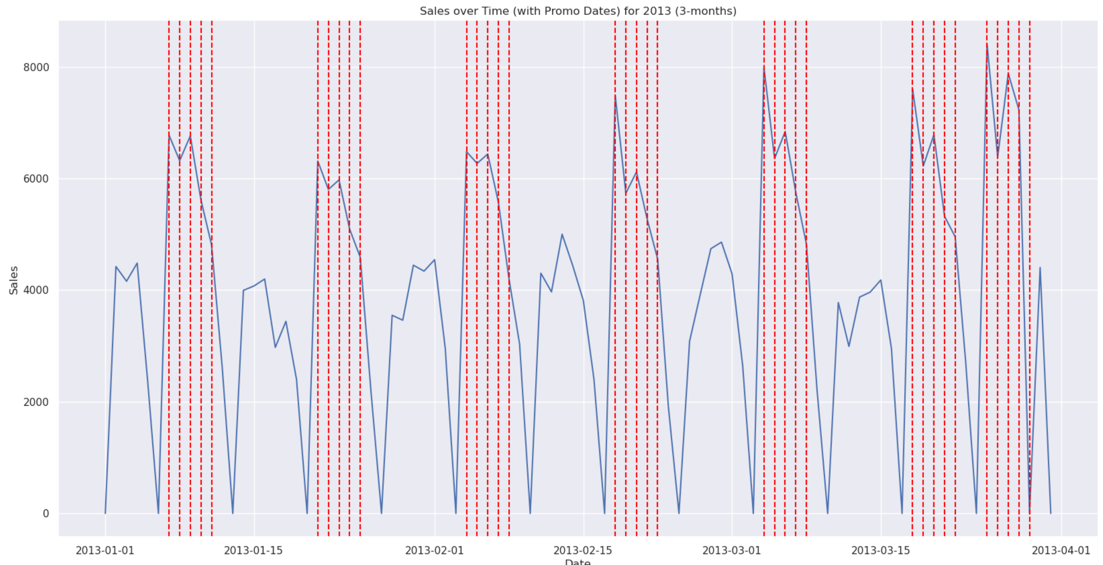
Sales increases from promotion periods may be ineffective due to customers predicting promotions will occur and buying items in bulk until future promotion occurs
Consistently scheduling store promotions… |  | …leads customers to successfully predict discounts
Pre-promotion sales dip
Post promotion sales dip
Consistently planned promotions and consecutive promotions can be seen across the 2013 year with slight sales dips from seasonality
Clear trends appear pre and post promotion periods depicting clear customer buying patterns
An apparent pre promotion sales dip indicates customers predict the promotion will occur and choose to not buy until the promotion takes effect
Similarly, a post promotion sales dip occurs from customers buying items in bulk to hold over until the next promotion occurs
Source: Team analysis

Slide 20



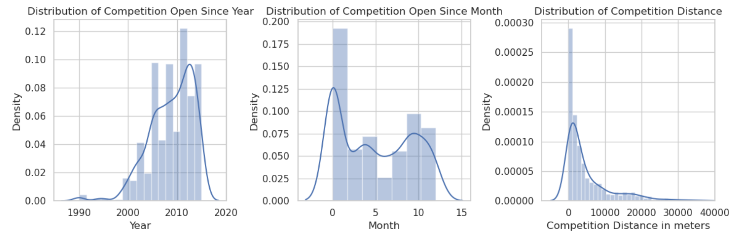
As more competitors enter the market in recent years and locate geographically close to retail stores, understanding competitor dynamics will be crucial to predict sales
Increasing competitive landscape in 15-year period
Competitors not entering the market in seasonal approach during years
Geographically close competitors create larger competitive environment
Increasing competitive landscape
Competitors enter market evenly throughout years
Most competitors located geographically close within shopping malls or high traffic areas
Peak competitors entering market between 2007 – 2013, with competition increasing aggressively until data cutoff
Customers do not consistently choose a specific month throughout the year to enter the market
As competitors enter the market, the desired choice is to enter closer to the drug stores which only increases competitive market
Source: Team analysis

Slide 21
As we build the prediction model, 5 noticeable takeaways from EDA will guide our approach to informing enhanced sales forecasts
Promotion Prediction
Customers ability to predict sales promotions, leading to a steep drop pre and post promotion, shows clear patterns to use in future forecasts.
Ineffective Promotions
Promotion 2 should be considered, on average, a net negative to future sales for predicting impact.
Geographically Close Competition
Competition is growing aggressively in the retail store market, especially as competitors choose to locate themselves in close proximity to the retail stores.
Closed Operations in Week/ Year
Store closures on Sunday’s and due to state and/ or store holiday’s negatively impact sales and should be understood when forecasting future sales.
Gradual Sales Increase In Year
Although quite minor, the gradual sales increase throughout the year should be integrated into the model to more accurately assess sales.
Source: Team analysis

Slide 22
04.
Modelling Performance

Slide 23

Our modeling approach integrates five models into a single ensemble for enhanced predictive performance overtime to limit model bias and increase robustness
Cross-Validation
Individual Performance
Ensemble Performance
Evaluation Metrics
Performed cross-validation utilizing a 75/25 train/ test split
Training data separated into smaller train and validate for purposes of training individual models
Individual model performance based upon five model types
Feature importance per model assessed to determine optimal features
Optimal models weighted based on linear regression
Weights utilized to determine final ensemble model for Kaggle competition in sales prediction
RMSE
MAE
R2
RMSLE
Source: Team analysis

Slide 24





Each of the five models brings a unique strength to the ensemble that balances to an improved long-term prediction tool for the drug stores
Generate unique models with varying strengths to consolidate into a single ensemble that emphasizes the strengths of each type
Key Modelling Infrastructure
Components
Linear
Regression
Random Forest
Light GB Model
Out a robust model that weights each input model based upon a linear regression assessment
Simple, interpretable model
that assists in identifying
linear relationships
present
Ensemble of numerous
prediction trees to overcome
decision tree limits and
outliers/ noise
Optimized approach for the numerous features within the
semi high dimensional
data
XGB Model
Ensemble
Model
Decision Tree
Capture complex interactions
between model features,
especially with categorical
features
Take advantage of regularization component to
reduce risk of overfit and
assess feature
importance
Combine strengths across
optimal models to enhance
accuracy and
interpretability
Source: Team analysis

Slide 25
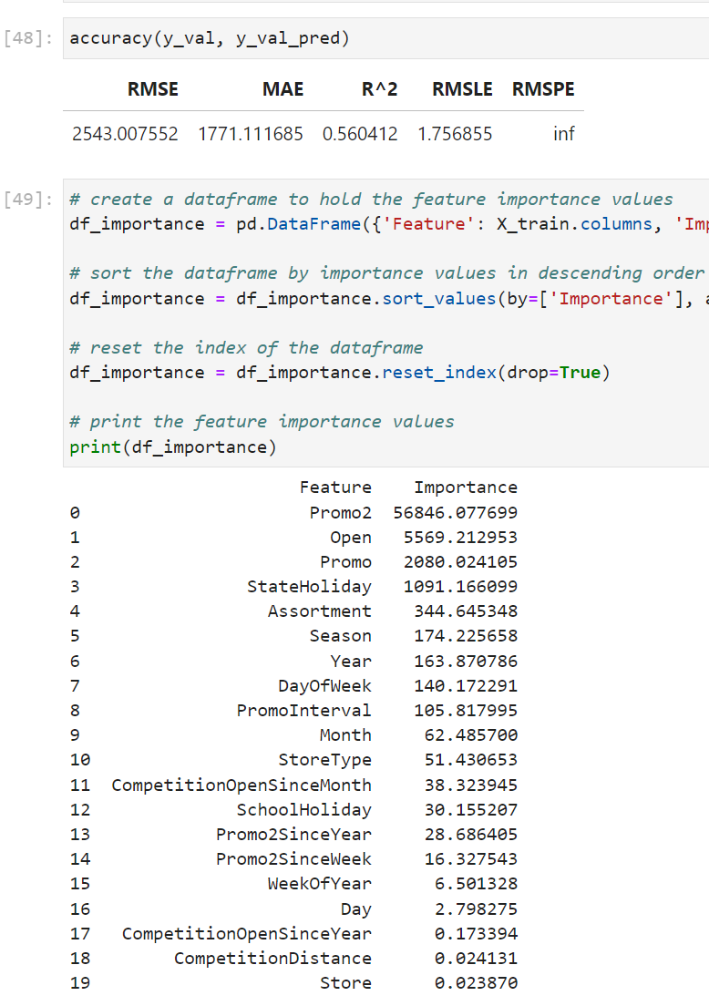
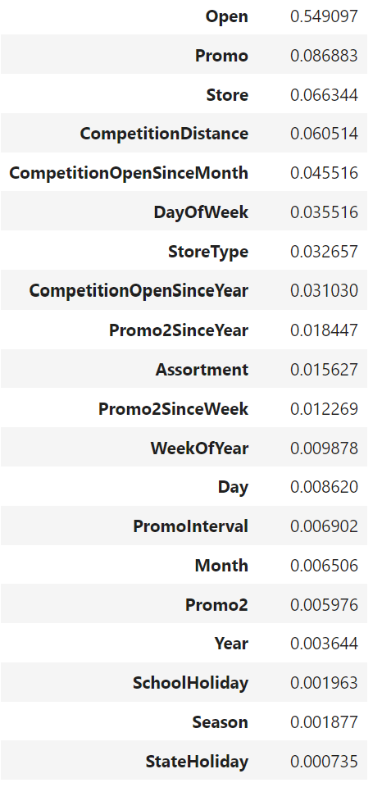
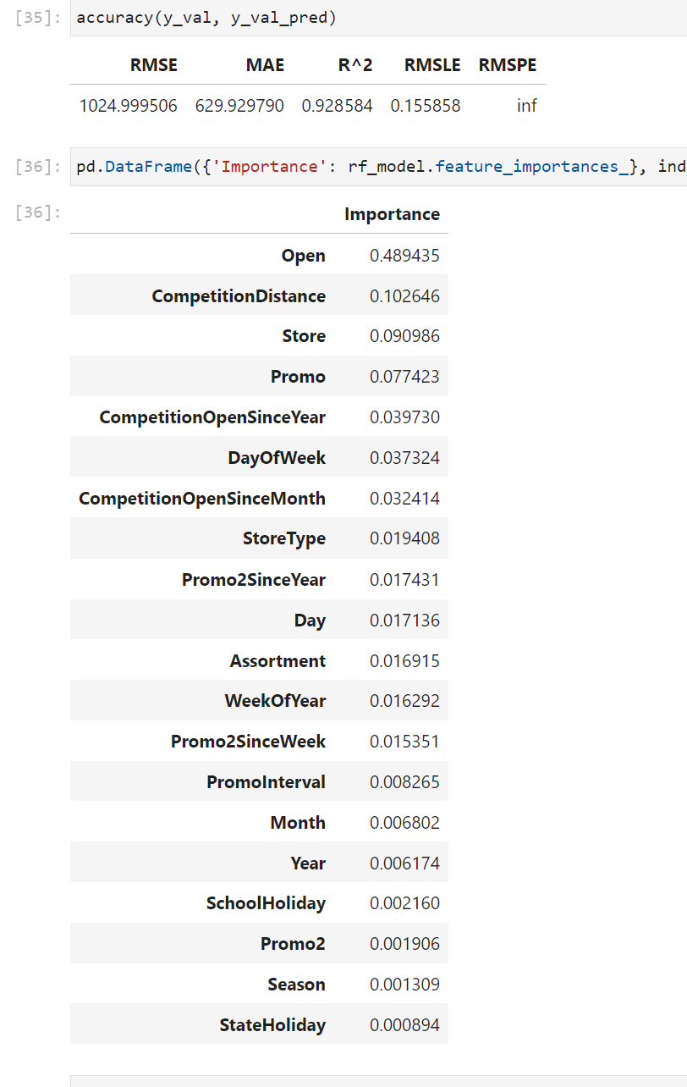
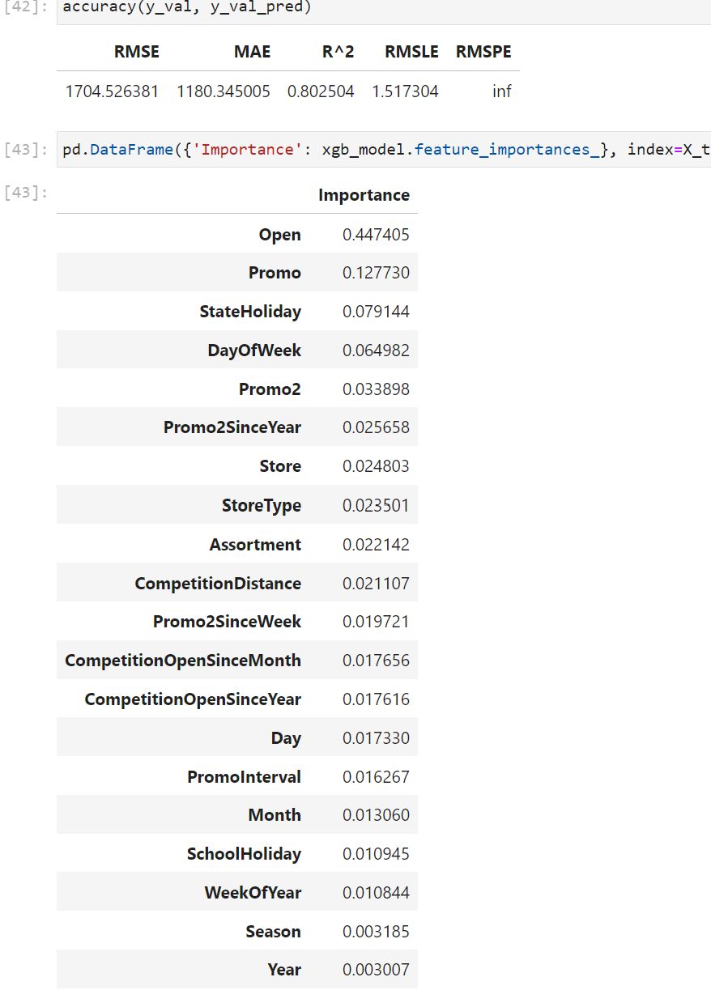
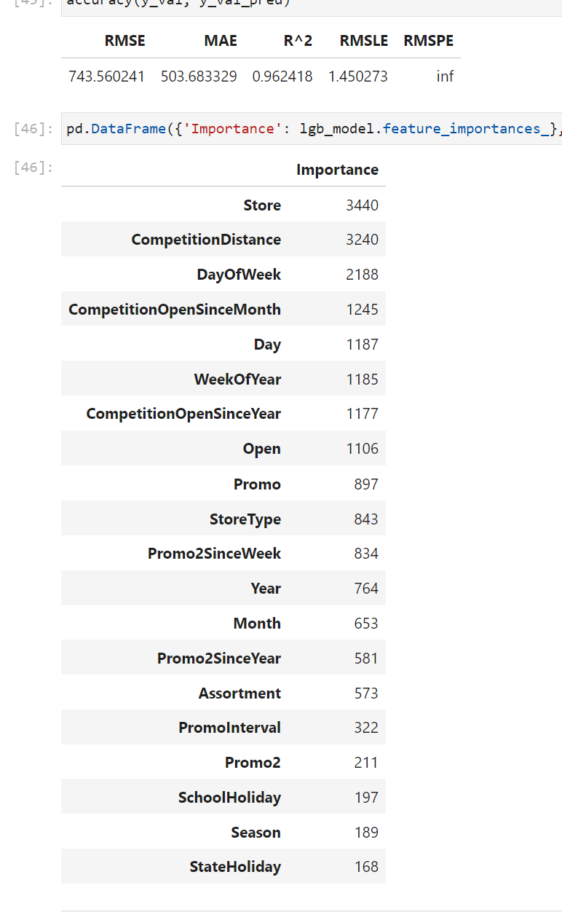
Prediction scores greatly enhanced as more advanced models were trained, providing a top R^2 score of 96% from the Light GB model
 | Linear Regression | Decision Tree | Random Forest | XGB | Light GB
Training Accuracy
Public Score | 11.65645 | 0.26695 | 0.22736 | 0.3014 | 0.13938
Private Score | 11.93165 | 0.27615 | 0.22954 | 0.30909 | 0.16726
Feature Importance
RMSE 2,543 | MAE 1,771
RMSLE 1.75 | R^2 0.56
RMSE 1,644 | MAE 1,013
RMSLE 0.23 | R^2 0.81
RMSE 1,024 | MAE 629
RMSLE 0.16 | R^2 0.92
RMSE 1,704 | MAE 1,180
RMSLE 1.52 | R^2 0.80
RMSE 743 | MAE 503
RMSLE 1.45 | R^2 0.96
Source: Team analysis

Slide 26

Performing a linear regression to appropriately weight each model type, a final ensemble model was produced that, although not optimal, balances bias and weaknesses from inputs
Linear
Regression
0.01715
Decision Tree
Ensemble Model
-0.01199
RMSE 679 | MAE 459
RMSLE 1.38 | R^2 0.96
Public Score 0.2236 | Private Score 0.23747
Random
Forest
0.34142
XG Boost
-0.14861
Light GB
0.80145
Intercept
4.29812
Source: Team analysis

Slide 27
05.
Qualitative Insights

Slide 28






Optimized pricing and promotion behavior for retail stores requires balancing the 3 lenses to pricing with human natures underlying psychological responses
Three Lenses to Pricing
Psychology to Pricing
Economics
Customer
Competitor
Involvement Level
Human Nature
Price Elasticity
2
Economics
Customers
4
Perception
1
Game Theory
Price Discrimination
Competitors
3
Comparison
Involvement
Source: GBUS 8047 - Darden Pricing

Slide 29
Pricing economics are built on 3 core pillars of the segments demand flexibility, stores local market share, and the size of the local channel
Three Lenses to Pricing
Psychology to Pricing
Economics
Customer
Competitor
Involvement Level
Human Nature
1
2
3
Shape of customer demand
influences segment elasticity
Market share is a strong
price elasticity predictor
Channel size
effects elasticity
Small Competitor reducing price by 5% through promotion can lead to stealing 5% market share from market leader
5%
Willingness to Pay (Price $)
Channel growth creates less price elasticity
Segment 1
Segment 2
Segment 3
Segment 4
# of Customers (by Segment)
Small Competitor
Lead Competitor
The drug stores should determine segment and elasticity of segment of customers
The retail stores require an enhanced understanding of each locations market share compared to competitors to understand promotion effectiveness
Smaller channels create more elasticity with prices and promotions which the stores should use in determining how to run future promotions
E<0 = Inferior Good | E=0 = Sticky Good | 0<E<1 = Necessity | E>1 = Luxury Good
Source: GBUS 8047 - Darden Pricing

Slide 30
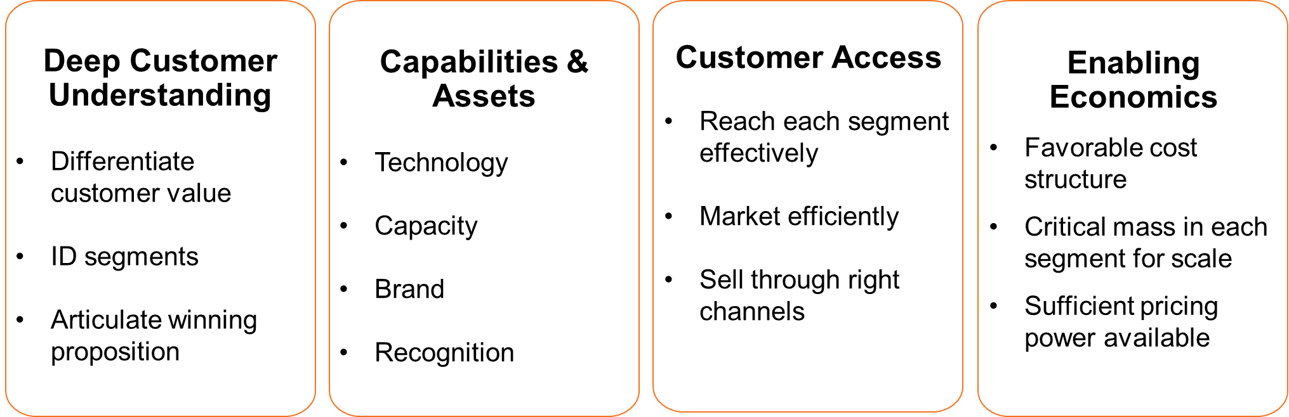



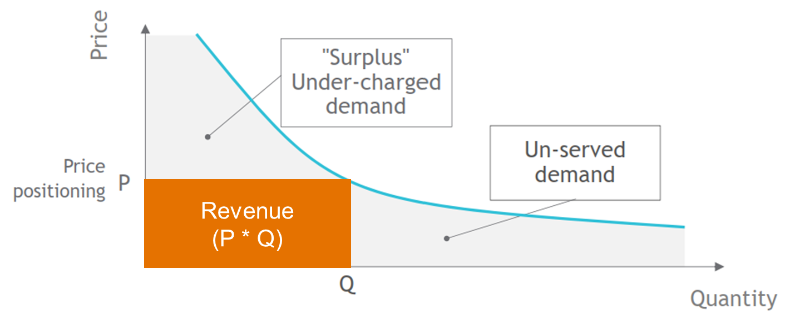
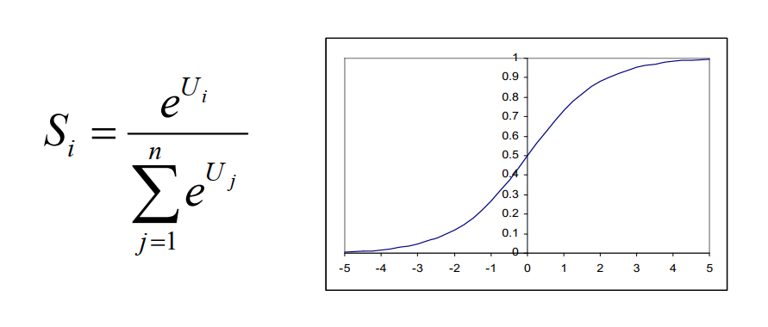
Retail customers are complex, requiring a balance of value drivers per customer segment with the propensity of each to buy
Three Lenses to Pricing
Psychology to Pricing
Economics
Customer
Competitor
Involvement Level
Human Nature
1
2
Utilize customer value drivers to enhance experience
Identify various customer segments to target
Technical Drivers |  | Functional Drivers |  | Emotional Drivers
Stores features that provide a technical benefit Connection to functional and emotional benefits KPI: Item availability |  | How customer experiences the product or service during the purchase process KPI: Experiences |  | How customer feels about the buying process based upon the brand perception, reputation, personal experience KPI: Satisfaction
4
3
Assess customer demand curve for opportunities
Calculate customer propensity to purchase for segments
Leverage conjoint analysis to identify value of attributes to customers
Determine price applicability on buying behavior and set promotions based upon analysis
Assess all outputs on utility of product to an individual customer
Source: GBUS 8047 - Darden Pricing

Slide 31






Competitors have rapidly crept into the retail stores geographic markets, requiring a balance of leading and reacting to price promotions
Three Lenses to Pricing
Psychology to Pricing
Economics
Customer
Competitor
Involvement Level
Human Nature
Three common competitor price models
Chart competitive response
War-game competitive landscape
 | Resulting degree of competitor response
 | Low | High
Competitor pricing strategy | Conservative | Advanced
Cross-elasticity w/ competitors | Low | High
Competitor’s strategy goals | Not in focus | Important
Competitor’s margin room | Low | High
Competitive Dynamics
Key Players | Product Categories | Customer Segments
Price Setting
Setting prices based upon value of next best alternative (i.e. substitute)
Key Players in Market
Price Moves
Active price management through war-gaming exercises
Product Categories
€
= large profit
= mid profit
= low profit
Price War
Avoid or break the vicious cycle between yourself and competitor
As Rossman competitors align promotions:
Do not initiate aggression to price war
Make response clear so that competitor does not misunderstand
Practice reciprocity if competitor is aggressive
Rules of thumb to approach wargame results:
Protect the castle by lower prices or running promotions
Attack competitor castles to gain market share/ increase sales
Avoid price reduction in grassland (capture adjacent grassland)
Do not respond to price wars in deserts
Source: GBUS 8047 - Darden Pricing

Slide 32
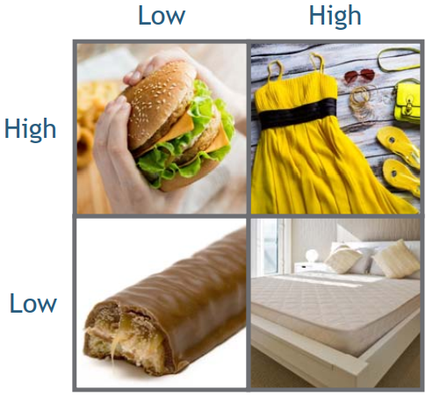
Customers have low visibility and involvement with drug store items, requiring competitive prices and promotions to retain the base against competitors
Three Lenses to Pricing
Psychology to Pricing
Economics
Customer
Competitor
Involvement Level
Human Nature
Customers make 4 types of purchase decisions…
…determined by external visibility & internal mental involvement…
…that the client should assess to understand their customer patterns.
Involvement
Involvement
Mental energy and time expended by customers in considering product purchase
Unconscious Decision (Low) vs. Complex Mental Thought (High)
Visibility
Level of visibility people have when consuming or using the product
Inconspicuous (Low) vs. Conspicuous (High)
Customers have low involvement in the decision to buy with primarily low visibility for drug store items
Customers have little time or mental energy expended on the decision to make store purchases
Price thresholds and price points significantly influence customer purchases
Price is a crucial factor in determining whether customers make repeat purchases
Customers actively seek deals to influence buying patterns in future
Visibility
Source: GBUS 8047 - Darden Pricing

Slide 33


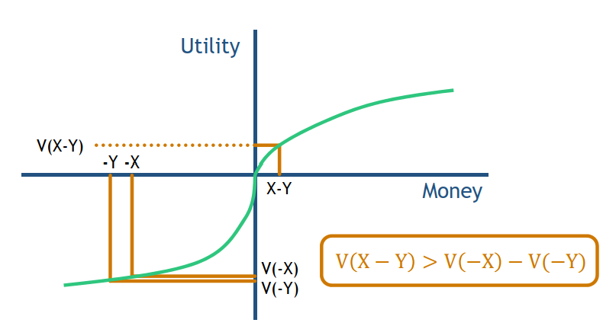
Drug stores should spread smaller, varied promotions for minor utility gains while integrating price raises at once to limit negative utility losses to the end customer
Three Lenses to Pricing
Psychology to Pricing
Economics
Customer
Competitor
Involvement Level
Human Nature
Utility curves emphasize negative > positive experiences |  | Commentary
Our brains see negatives more clearly than positives due to human evolution to survive
A negative impact to a customer is felt more than an equivalent positive impact due to how we value negative vs. positive utility
Ex. Price raise of $5 creates more anger for a customer than a $5 promotion creates happiness
Promotions should be small, spread out, and varied for customers to receive consistently small utility increases (receive greater utility from multiple positive results than all at once)
Price raises should come all at once toward end of negative utility function where customer experiences diminishing rate (integrate losses)
Provide small promotion gains here
Raise prices for customers here
Source: GBUS 8047 - Darden Pricing

Slide 34
06.
Final Recommendations

Slide 35
Qualitative and quantitative insights have led to four key recommendations surrounding promotions, customers, and competition to enhance future store sales
Key recommendations
Assessment
Expected Impact
Enhance Promotion Effectiveness
Remove consecutive promotions (promo 2) due to ineffectiveness in increasing sales or profit
Randomize future promotions to limit customers predicting promotions and stockpiling goods
Run frequent, smaller promotions to incentivize recurring customer shopping patterns
Bundle all price increases for one time to limit negative utility impact to customers
Utilize Elasticity of Demand
Segment customer base and evaluate each segments level of demand
Calculate market share and channel size of stores across markets for reviewing pricing power
Utilize inputs to analyze elasticity of demand for customers and set promotions based on result
Understand Competitive Mindset and Tactics
Assess competitive pricing and promotion strategy in terms of impact to future sales
Determine competitive response to historical store promotions
War-game pricing and promotion landscape to optimize strategy for future response
Target Customer Value Drivers
Weight three customer value drivers to determine customer preferences
Align store experience and promotions to weighted drivers to increase customer surplus
Enhance customer propensity to buy to increase customer basket size
Very limited
…
Substantial
Realistic / favorable
Challenging
Adverse / potentially critical
Source: GBUS 8047 - Darden Pricing

Slide 36
Thank You.

